Slide 1
What is Git?
An Introduction

Slide 2

According to Wikipedia…
Git is a distributed revision control system with an emphasis on speed, data integrity, and support for distributed, non-linear workflows. Git was initially designed and developed by Linus Torvalds for Linux kernel development in 2005, and has since become one of the most widely adopted version control systems for software development.
Revision control, also known as version control or source control, is the management of changes to documents, computer programs, and other collections of information. Changes are usually identified by a number or letter code, termed the "revision number," "revision level," or simply "revision.”

Slide 3
Wat?
It keeps a history of every change you make.

Slide 4


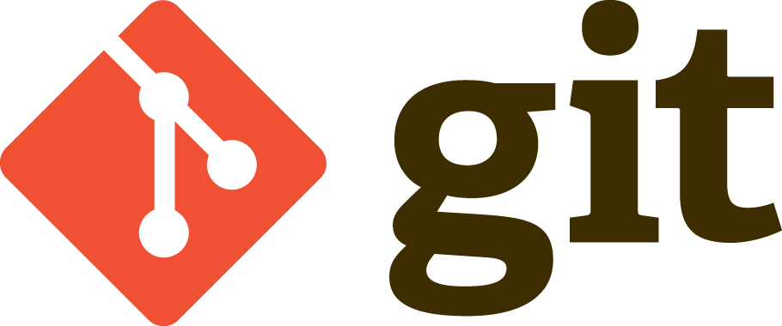
GitHubs. Yeah. I’ve heard of those.

Slide 5
So how does this work?
This is the part where I show you how you might use this.

